Slide 1
Virtualisation + Security

Slide 2
Today’s Plan
9:00 – 9:30: Virtualisation Security (Various Sources).
9:30 – 10:00: Course Review.
10:00 – 12:00 Coursework.

Slide 3
Security Issues

Slide 4
Security Violations
Five most typical security violations:
Breach of confidentiality: Unauthorised reading of data (e.g. identity information, credit card numbers, etc.).
Breach of integrity: Unauthorised modification of data (e.g. modification of the source code of an important commercial application).
Breach of availability: Unauthorised destruction of data (e.g. website defacement).
Theft of service: Unauthorised use of resources (e.g. installing unauthorised software).
Denial of service: Preventing legitimate use of the system (e.g. worms).

Slide 5

Levels of Impact for Organisations
Low: An anonymous online poll used by a news organisation for subscribers and random users.
Medium: A Moodle-type website that offers a forum facility to the students undertaking a particular module.
High: A hospital patients’ medical record system.

Slide 6
Virtualisation Recap

Slide 7
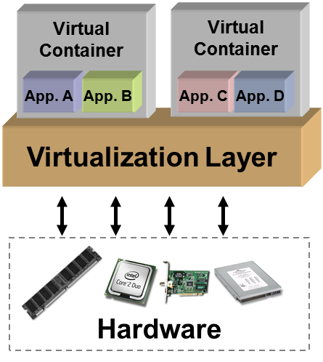
Virtualisation Recap
Creation of a layer that maps the interface of a system (virtual machine) or component (i.e., I/O device) onto the interface and resources of an underlying (possibly different) real system.
Purposes:
Abstraction
Replication
Isolation
Cross compatibility/Encapsulation
Does not necessarily aim to simplify or hide details.
Managed by a virtual machine monitor (VMM).
© 2008 Crossbeam Systems

Slide 8
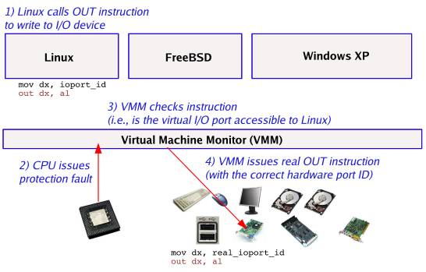
VMM Trap
© Matt Welsh – Harvard University, 2006

Slide 9
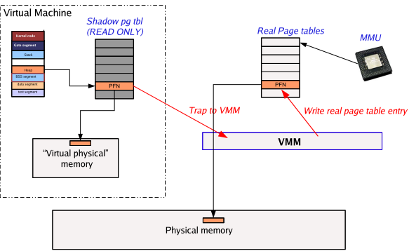
Virtualisation of Memory
© Matt Welsh – Harvard University, 2006

Slide 10
Vulnerabilities of VM

Slide 11
Vulnerabilities of Virtualisation
Gaining access to the guest and/or the host OS?
Guest OS
Guest OS
Guest OS
Hypervisor
How robust is the hypervisor?
Vulnerabilities in the underlying OS?
Host OS
© 2009 Crossbeam Systems

Slide 12
Virtualisation Security Issues
Hypervisor is the underlying component of all these architectures. It is a new layer which needs to be protected!
Scale of deployments:
e.g. 150 virtual machines running a simultaneous scheduled anti-virus (AV) scan on the same physical host.
Isolation: Machines of a company and its competitor could be running on the same physical machine.
Insufficient isolation could lead to attacks.
Guest OS monitoring by the hypervisor, which has privileged access rights.
New APIs to access virtualization services:
Bugs in these could lead to compromise of entire infrastructure.
Source: Huzur Saran– IIT Delhi, 2009
Notes:
API: Application Program Interface

Slide 13
Operational Security Issues
Most security issues arise not from the virtualisation infrastructure itself but from operational issues.
Adapting existing security processes and solutions to work in the virtualised environment.
Most security solutions do not care whether a machine is physical or virtual.
The risk of misconfiguration requires use of best practices specific to virtualisation.
VMWare.
Erick Halter (co-author of Virtualization: From the desktop to the enterprise).
Sources: Huzur Saran– IIT Delhi, 2009
https://www.vmware.com/content/dam/digitalmarketing/vmware/en/pdf/whitepaper/partners/intel/vmware-intel-best-practices-white-paper.pdf
https://searchservervirtualization.techtarget.com/tip/Best-practices-for-getting-started-with-virtualization

Slide 14
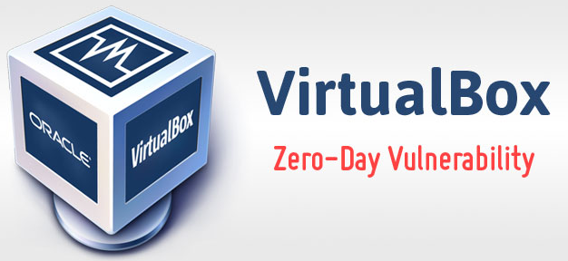
Unpatched VirtualBox Zero-Day Vulnerability
Allow malware to escape VM and execute code on host OS.
Occurs due to memory corruption issues on Intel PRO / 1000 MT Desktop (82540EM) network card (E1000) when the network mode is set to NAT.
DEMO
How to protect: No patch yet available!
Change the network card of the VM to PCnet or to Paravirtualised Network.
Source: https://thehackernews.com/2018/11/virtualbox-zero-day-exploit.html
Notes:
-Quite specific flaw in HW!

Slide 15
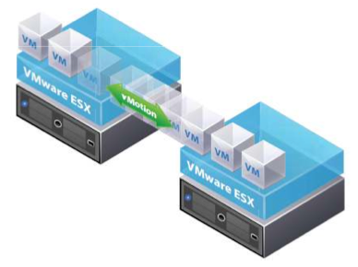
VM Migration
Transfer from one physical server to another with little or no downtime:
For load balancing and high availability.
If transfer is unencrypted, man-in-the-middle attack is possible, allowing changes to the VM enroute.
© VMWare Vmotion brochure

Slide 16
Defending Virtualised Systems

Slide 17
Principles and Best Practices
Open design: You need all the help you can get.
Economy of mechanism: Fewer things to get right.
Minimize secrets: Secrets do not remain secret.
Fail-safe defaults: Most users won’t change them.
Least privilege: Limit the damage of an accident.
Separation of privilege: Dangerous operation should require multiple principles.
Complete mediation: Check every operation.
Defence-in-depth?
Source: Huzur Saran– IIT Delhi, 2009

Slide 18
Hypervisor Security
Hypervisors are written by humans:
They have bugs, typically buffer overflows.
Hypervisor are complex:
Xen is about 300K source lines of code!
Should be installed in isolated environment and updated to the latest path level:
The same approaches as to OS security.
Complete isolation is hard:
Most systems do not have input–output memory management unit (IOMMU) which make it possible to enable direct memory access (DMA) to arbitrary physical memory.
Access to hypervisor should be limited to authorised administrators only.
Use trusted hypervisors.
Use hypervisor malware security:
Hyperguard (Phoenix Technologies): Hypervisor integrity scanner.
Deepwatch (Intel Project): Virtualisation rootkit scanner.
Source: Huzur Saran– IIT Delhi, 2009

Slide 19
Dedicated VM Security
AV
F
W
AV
F
W
AV
F
W
AV
F
W
AV
F
W
AV
F
W
OS
OS
OS
OS
OS
OS
Enterprise Hypervisor
Hardware
Is it a good idea?
Antivirus
Firewall
OS
OS
OS
OS
OS
OS
Enterprise Hypervisor
AV Shim
FW Shim
Hardware
Source: Huzur Saran– IIT Delhi, 2009
Notes:
Shim: An engineering term used to describe a piece of wood or metal that is inserted between two objects to make them fit together better.
In computer programming, a shim is a small library which transparently intercepts an API, changes the parameters passed, handles the operation itself, or redirects the operation elsewhere. Shims can also be used for running programs on different software platforms than they were developed for.

Slide 20
Security Advantages of Virtualisation
Better forensics:
A compromised machine can be cloned in it current compromised state for forensic analysis.
Faster recovery after an attack:
Once cloned, the VM can be immediately restored to a known good snapshot which is much faster than a physical server, reducing the impact of a security-related event.
Safe Patching:
You can quickly revert to a previous state if a patch is unsuccessful, making you more likely to install security patches sooner.
You can create a clone of a production server easily, making you more likely to test security patches and more likely to install security patches.
More Effective Patching:
VMware Update Manager allows patch scanning and compliance reporting, along with patch remediation for both online and offline VMs.
More Cost Effective Security Devices.
You can put in place cost effective intrusion detection, vulnerability scanning, and other security related appliances which become global for all virtual environments.
Security Abstraction
Provide protection from outside the OS, from a trusted context.
View all interactions in such context.

Slide 21
Security Disadvantages of Virtualisation
Single point of failure.
Trusted hypervisor.
Trusted secure context outside the OS of the VM.
Amount of memory required to store VM images.
Amount of memory required to store VM snapshots.

Slide 22
Course Review

Slide 23
Week 1: Virtualisation
Definition
Pro’s and con’s
Types
Type I
Type II
Type Hybrid
Abstraction vs Virtualisation
Techniques to Virtualise the x86 architecture
Full
Para-virtualisation/OS assisted
Hardware assisted
Relation between types and techniques
Other uses of virtualisation
Memory virtualisation
Application virtualisation
Virtual machines

Slide 24
Week 2-3: The Security Landscape and Controlling Computers
Security Landscape
Rule-based
Relativistic-based
Rational
Security Process
Six steps
Features-shared
Program Execution
Data & control sections
Programs and processes
Switching processes
Buffer overflows & the Morris worm
The finger protocol
Fighting the worm and aftermath
Access Control Strategies for Processes
Island
Vaults
Puzzles
Patterns
Principles
Open design
Chain of Control
Keeping Processes Separate
Hardware separation
Software separation
Sharing data & access matrix
Linux shell commands & scripting

Slide 25
Week 4: Managing Files
Controlling (accessing) files
File system
File ownership & access rights
Directory access rights
Executable Files
Execution access rights
Viruses in executable files
Sharing & Protecting Files
Global policies
Isolation
File-sharing
Tailored Policies
Privacy
Shared reading
Shared updating
Managing Access Rights
Access rights matrix
Solution 1: By row (file permissions)
Permission Flags (Unix)
Solution 2: By column (capability-based security)
Access Control Lists (Windows)
Python
Pro’s and con’s
Data structures

Slide 26
Week 5: Authenticating Users
Factors
Know (passwords)
Have (tokens)
Are (biometrics)
Others?
Multi-factor
Attacks on Authentication (general)
Passwords
Authentication
Hashing
crypt()
Password guessing/cracking
How fast?
Increasing the search space (fixed/range)
Reducing the search space
Dictionary attack
How fast is it?
Fixed length
Range of length
Tokens
Pro’s and Con’s
Types
Passive
Active
Challenge response authentication
Biometrics
Accuracy
Authentication requirements
Threats and motivations
Weak
Strong
Extreme

Slide 27
Week 6: Firewalls and Security Protocols
Firewalls
Packet filter
TCP ACK Attack
Stateful packet filter
Application proxy
Defence-in-Depth
Secure Shell (SSH)
Diffie-Hellman
SSH simplified
Attacks on SSH
Secure Socket Layer (SSL)
SSL simplified
Attacks on SSL

Slide 28
Week 7: Malware
Definition
Types
Parasitic
Independent
Propagation Mechanisms
Virus
Worm
Trojan Horse
Types of Payload
Data destruction
Data kidnapping
Real-world damage
Logic bombs
Bots/Zombies
Information theft (phishing)
Stealthing (rootkits)

Slide 29
Week 8: Operating System Security
Protection vs security
Access control
Protection of objects
OS Hardening
Trusted computer base
Security maintenance
Security threat monitoring
OS Security case studies
Linux
Access control
Pluggable Authentication Modules
Vulnerabilities
Windows
Facilities
User authentication
Vulnerabilities

Slide 30
Week 9: Malware and Software Security
Malware prevention
Elements
Effective countermeasures
Technical mechanisms
Places
In host
Simple scanner
Heuristic scanner
Activity traps
Full-feature protection
Generic Decryption
Host Based Behaviour Blocking System
Spyware detection and removal
Rootkit countermeasures
In network
Ingress monitors
Egress monitors
In general
Distributed Intelligence Gathering
Software security
Intended vs implemented
Types of flaws
Bugs
Trap door
Bad software
Software insecurity
Software security assurance
Software security questions
Software security examples
Software security categories
Insecure interaction
Risky resource management
Porous defences
Handling input
Software security best practices

Slide 31
Week 10: Virtualisation + Security
Security Issues
Violations
Breach of confidentiality
Breach of integrity
Breach of availability
Theft of service
Denial of service
Level of impacts for organisations
Low
Medium
High
Vulnerabilities of a VM
Security issues
Operational issues
Defending virtualised systems
Principles and best practices
Hypervisor security
Dedicated VM security
Virtualisation for security
Pro’s and con’s

